Slide 1

September 17, 2025
NOISE MONITOR UPDATE

Slide 2
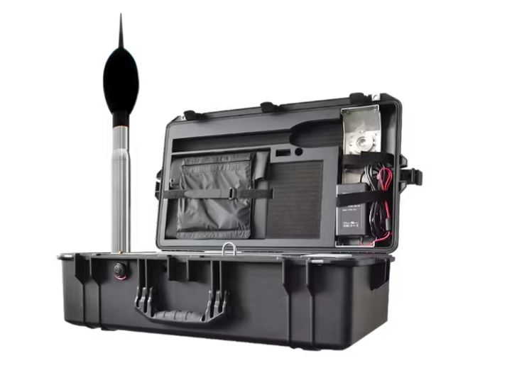
NOISE MONITORS
HVN purchased 2 portable noise monitors.
Monitors are currently deployed on airport property to collect baseline data.
The objective is to deploy portable monitors to nearby public or private properties (with property owner’s consent) to collect further data.
Data is helpful in determining actual community impacts and is intended to be used for the eventual formation of an FAA Community Roundtable.
FAA Community Roundtables facilitate understanding of noise-related issues and can potentially be used to update flight paths.

Slide 3
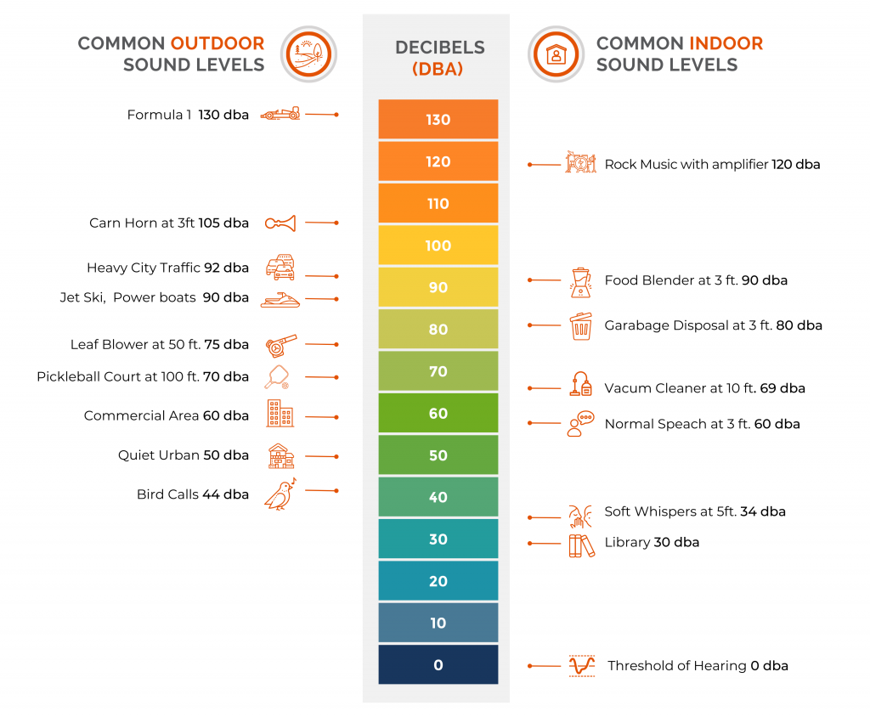
COMMON SOUND LEVELS
Noise events are recorded when the industry standard of 65 dB for greater than 3 seconds is met or exceeded
Monitors differentiate between aircraft noise (both APF and non-APF) and community noise
Community noise may include, but is not limited to, the types described in the chart

Slide 4
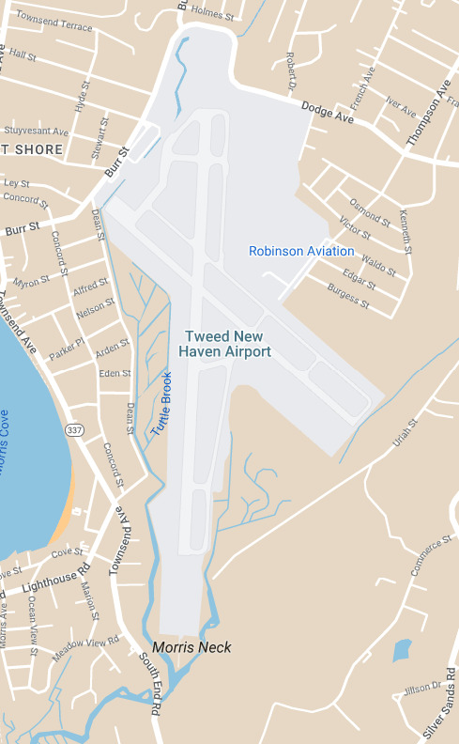
NOISE MONITOR DEPLOYMENT
Phase | Location | Location Name | Date Range
III | A | Main Entrance | 5/1-8/20
 | B | Robinson Aviation/Ops
A
B

Slide 5
RESULTS
✈ All data captured from 5/1/2025-8/20/2025
Location | Location Name |  | Aircraft Noise Events |  |  |  | Community Noise Events
 |  | Time on Site | Average # of Daily Events | Average Event Duration | Cum. Average Daily Duration | Peak (LMax) | Peak (LMax)
Phase IV | A – Main Entrance | ~111 days | 31 | 20 seconds | 10 minutes | 102 dB | 105 dB
 | B – Robinson / Ops | ~111 days | 42 | 20 seconds | 14 minutes | 93 dB | 109 dB
✈ This data set reflects the noise monitors currently on airport property in closest proximity to arriving and departing aircraft.
✈ Data gaps may exist due to temporary outage of Monitor B near Robsinon/Ops.
A – Main Entrance
B – Robinson / Ops

Slide 6
TOTAL RESULTS
✈ All data captured from 5/1/2025-8/20/2025
Aircraft noise events by aircraft category
✈ Of all total aircraft-related noise events registered between 5/1-8/20, approximately 47% were related to commercial aircraft, with the remaining 53% a combination of business jets, helicopters, pistons and turboprops.

Slide 7
TOTAL RESULTS
✈ All data captured from 5/1/2025-8/20/2025
Aircraft noise events by decibel range
✈ A slight majority of aircraft-related noise events registered between 75-84 dB Lmax.

Slide 8
TOTAL RESULTS
✈ All data captured from 5/1/2025-8/20/2025
Average aircraft noise events by time of day (2hr blocks)
✈ On average, aircraft noise events peak between 2:00PM – 4:00PM daily.

Slide 9
NOISE INQUIRIES
✈ All data captured from 5/1/2025-8/20/2025
Noise inquiries by reason (unique users)
✈ There were 30 unique inquirers which generated 69 total inquiries.
✈ Most inquiries were related to low flying aircraft (10x), followed by too late (9x).

Slide 10
FAQ
What is the limit on aircraft noise?
There is no specific limit on aircraft noise. Aircraft noise is federally regulated by the Federal Aviation Administration (FAA) under Federal Aviation Regulation (FAR) Part 36.
Does HVN have a curfew?
HVN is a public-use airport and signatory of Grant Assurance 22, which means that we cannot legally prohibit aircraft from operating during specific hours.
As part of HVN’s commitment to the community and partnership with our commercial air carriers, both Avelo Airlines and Breeze Airways have voluntarily agreed to restrict their hours of operations to 6:30 AM and 11:00 PM, except for delayed and repositioned flights.

Slide 11
WHAT’S NEXT
HVN will continue to collect and analyze noise data.
HVN’s next report will include new data from residential home deployments.
HVN will pause noise monitoring during the winter months.
HVN will continue to update the TNHAA and TNHAA Board on results and community interest.

Slide 13
How is aircraft noise measured?
According to the Federal Aviation Administration (FAA), aircraft noise is measured in A-weighted decibels (dBA). This scale most closely approximates the way humans hear sound.
Here are three noise measurements to understand:
Lmax: For noise sources in motion, like aircraft, noise levels can change over time. For example, the sound level of a plane increases as it approaches, and then as it flies away the sound level decreases. Measuring the maximum sound level, abbreviated as Lmax, can be useful for measuring a particular noise ‘event’. While Lmax notes the moment of maximum sound level, it does not account for the duration of a sound event. To account for the differences in duration and loudness of sounds, different metrics are used, including SEL.
Sound Exposure Level (SEL): SEL represents all the acoustic energy (a.k.a. sound pressure) of an individual noise event as if that event had occurred within a one-second time period. SEL captures both the level (magnitude) and the duration of a sound event in a single numerical quantity, by “squeezing” all the noise energy from an event into one second. This provides a uniform way to compare noise events of various durations.
Day-Night Average Sound Level (DNL): The DNL noise metric measures a person’s cumulative exposure to sound over a 24-hour period, expressed as the noise level for the average day of the year based on annual aircraft operations. The DNL noise metric provides a mechanism to describe the effects of environmental noise in a simple and uniform way. DNL is the standard noise metric used for all FAA studies of aviation noise exposure in airport communities.
Maximum sound level, but does not adjust for duration
Compressed to 1-second, adjusts for duration – better for comparing noise events.
Cumulative noise exposure over 24-hours, expressed as noise level for average day of the year based on annual aircraft operations.

